Slide 1
Warm-up!
Why do you cry, Willy?
Why do you cry?
Why, Willy?
Why, Willy?
Why, Willy? Why?

Slide 2
Theme:
Holidays in the USA
The aims: To develop student's abilities in speech;
To arouse student's interest in the USA and to widen their scope;

Slide 3
Say when the following festivals are celebrated in the USA
St. Valentine's Day - April 1
New Year's Day - November 4th Thursday
Independence Day - July, 4
Halloween - December, 25
Thanksgiving Day - February 14
Christmas Day - January 1
April Fools' Day - October 31

Slide 4
Venn diagram
USA
KAZAKHSTAN

Slide 5
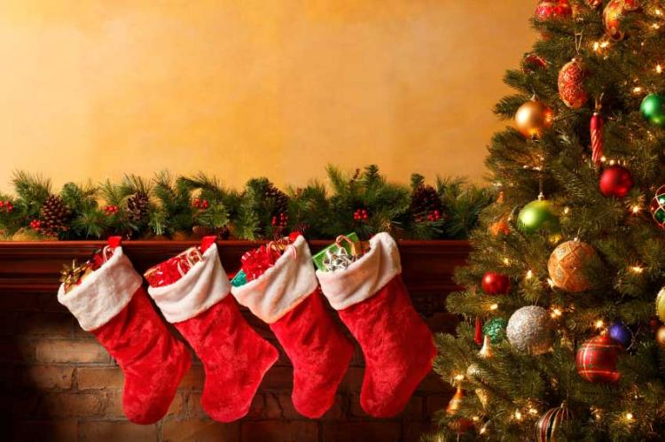
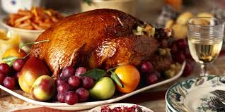
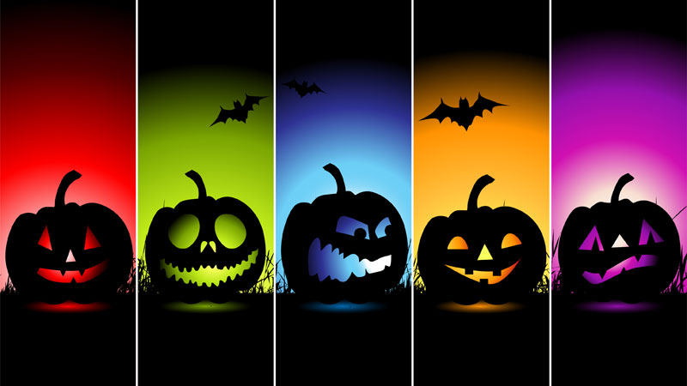
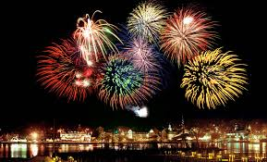
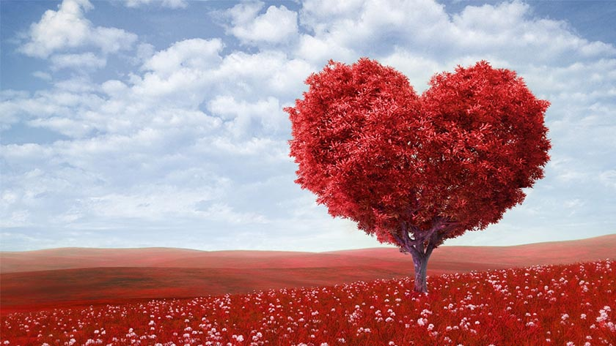

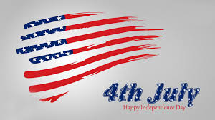
What is the holiday?

Slide 6
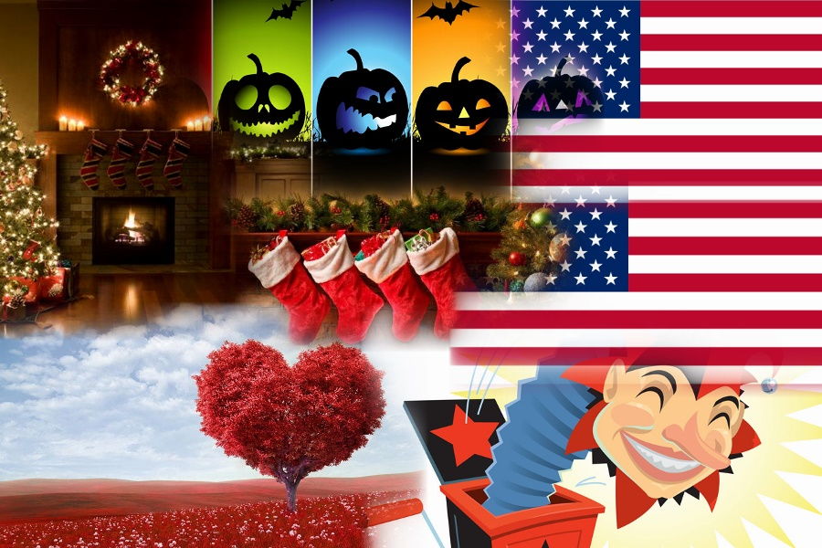

Slide 7

Home task:
Ex.1 page 201
Compare the celebration of the New Year in different countries.

Slide 8
Crossword

